Slide 1
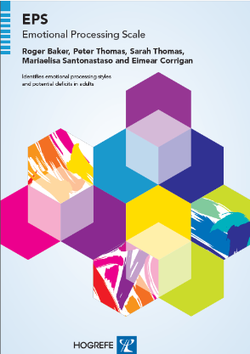
Background and development of the emotional processing scale

Slide 2
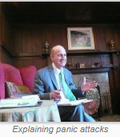
the development of the EPS by Roger Baker
The original items for the scale were based on a conceptual model developed over many years, clinical and research interviews, case histories, personal experiences, autobiographies and the emotion literature. It was
informed by major emotion theories, cognitive theories and experiential theories, by behaviour therapy, cognitive therapy, experiential therapy, psychotherapy, and the fields of psychosomatics, medicine and
neuropsychology.

Slide 3
Control of three emotions: Anger, Sadness and Anxiety
Strong control
Control
Slight control
n = 48 n = 118 n = 387

Slide 4

Other Emotional Processing Dimensions
(expressed as means and standard deviation
 | Panic Disorder Group | Scottish Healthy Controls | t Value | P
Awareness of feelings | 3.6 (0.6) | 3.1 (0.7) | 3.5 | .001
Able to label emotions | 2.2 (0.9) | 1.7 (0.8) | 3 | .01
Controlling the experience of emotion | 18 (4.3) | 13.6 (4.3) | 4.5 | .0000
Control the expression of emotion | 45 (5.0) | 39.6 (9.4) | 3.1 | .01
Notes:
Does not require translation

Slide 5
Emotional processing and panic
Reference:
Baker R., Holloway J., Thomas P.W., Thomas S., Owens M. (2004) Emotional Processing and Panic. Behaviour Research & Therapy. 42,1271-1207

Slide 6

Reference:
Baker, R. (2004). Understanding Panic Attacks and Overcoming Fear. Oxford: Lion-Hudson

Slide 7
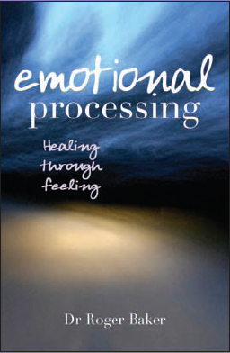
Reference:
Baker, R. (2007) Emotional Processing: Healing through Feeling. Oxford, Lion-Hudson

Slide 8
Initial item selection
Clinical experience
Schematic
model
Case histories
Literature
300 draft items/ideas
152-items
101-items
Notes:
Adaptation development and manualisation.
Phase 1 involved the following strands.
I will talk in a little more detail about each of these.

Slide 9
Development of Emotional Processing Scale
Version 1
101 questions
Given to
60 healthy people
53 patients visiting the doctor
37 mental health patients
n = 150
Analysis of data

Slide 10
Development of Emotional Processing Scale
Version 2
45 questions
Given to
100 students
73 older healthy people
124 cancer patients
16 back pain patients
147 mental health patients
n = 460
Analysis of data

Slide 11
Development of Emotional Processing Scale
Version 3
53 questions
Given to
310 healthy people
86 patients visiting the doctor
114 pain patients
180 mental health patients
n = 690
Analysis of data

Slide 12
Development of Emotional Processing Scale
FINAL VERSION
25
QUESTIONS

Slide 13
How the questionnaire is rated
1. I smothered my feelings.
0 | 1 | 2 | 3 | 4 | 5 | 6 | 7 | 8 | 9
completely---------------------- disagree--------------------------in between ------------------------- agree------------------------ completely
disagree agree
2. Unwanted feelings kept intruding.
0 | 1 | 2 | 3 | 4 | 5 | 6 | 7 | 8 | 9
completely----------------------- disagree-------------------------in between ------------------------- agree------------------------ completely
disagree agree
3. When upset or angry it was difficult to control what I said.
0 | 1 | 2 | 3 | 4 | 5 | 6 | 7 | 8 | 9
completely----------------------- disagree-------------------------in between ------------------------- agree------------------------ completely
disagree agree

Slide 14
There are three articles on the Development of the scale:
References:
Baker, R., Thomas, S., Thomas, P.W., Owens, M. (2007) Development of an Emotional Processing Scale. Journal of Psychosomatic Research, 62: 167-178
Baker R, Thomas S, Thomas P, Gower R, Santonastaso M, Whittlesea A. (2009)
The Emotional Processing Scale: Scale refinement and abridgement (EPS-25)
Journal of Psychosomatic Research 68, 1, 83-88
Baker R, Owens M, Thomas S, Whittlesea A, Abbey G, Gower P, Tosunlar L, Corrigan E, Thomas PW: Does CBT facilitate emotional processing? Behav Cogn Psychother; 2012 Jan;40(1):19-37

Slide 15
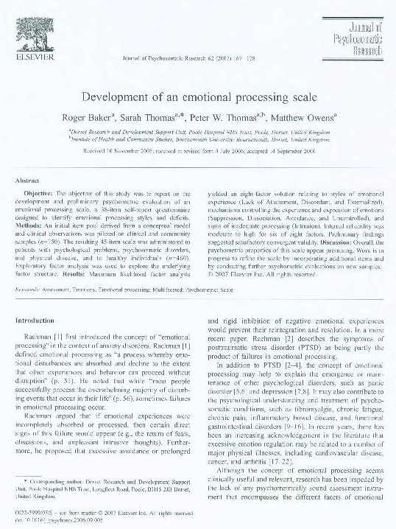

Slide 16
